Slide 1

Analysing Regional Sales Performance
Sales performance Analysis and Trending in the U.S.A
Insights and Recommendations

Slide 2
Introduction
Objective: The primary goal of this analysis is to explore the relationship between product lines, order sizes, and sales performance across different years. By understanding these patterns, we aim to identify key drivers behind sales volume fluctuations, uncover regional preferences, and provide actionable insights for optimizing sales strategies.
Dataset Overview:
The dataset used in this analysis comprises retail order information, such as order quantity, unit price, product line and order date. The data spans from 2003 to 2005 and covers various product lines. Additionally, the dataset provides insights into sales trends across multiple cities in the U.S.A.

Slide 3
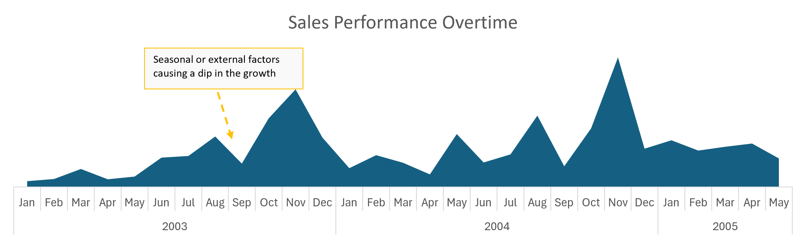
How do sales figures vary over time?
- Peaks of volume of sales in certain months such as August, November and December.
- Peaks might indicate holiday shopping behaviour.
- Possible seasonality effect where sales might peak during specific months of the year.
Recommendations:
Further analysis of correlation with specific marketing campaigns or external factors to understand their impact better.
Dashboard for deeper dives into specific regions or product lines.

Slide 4
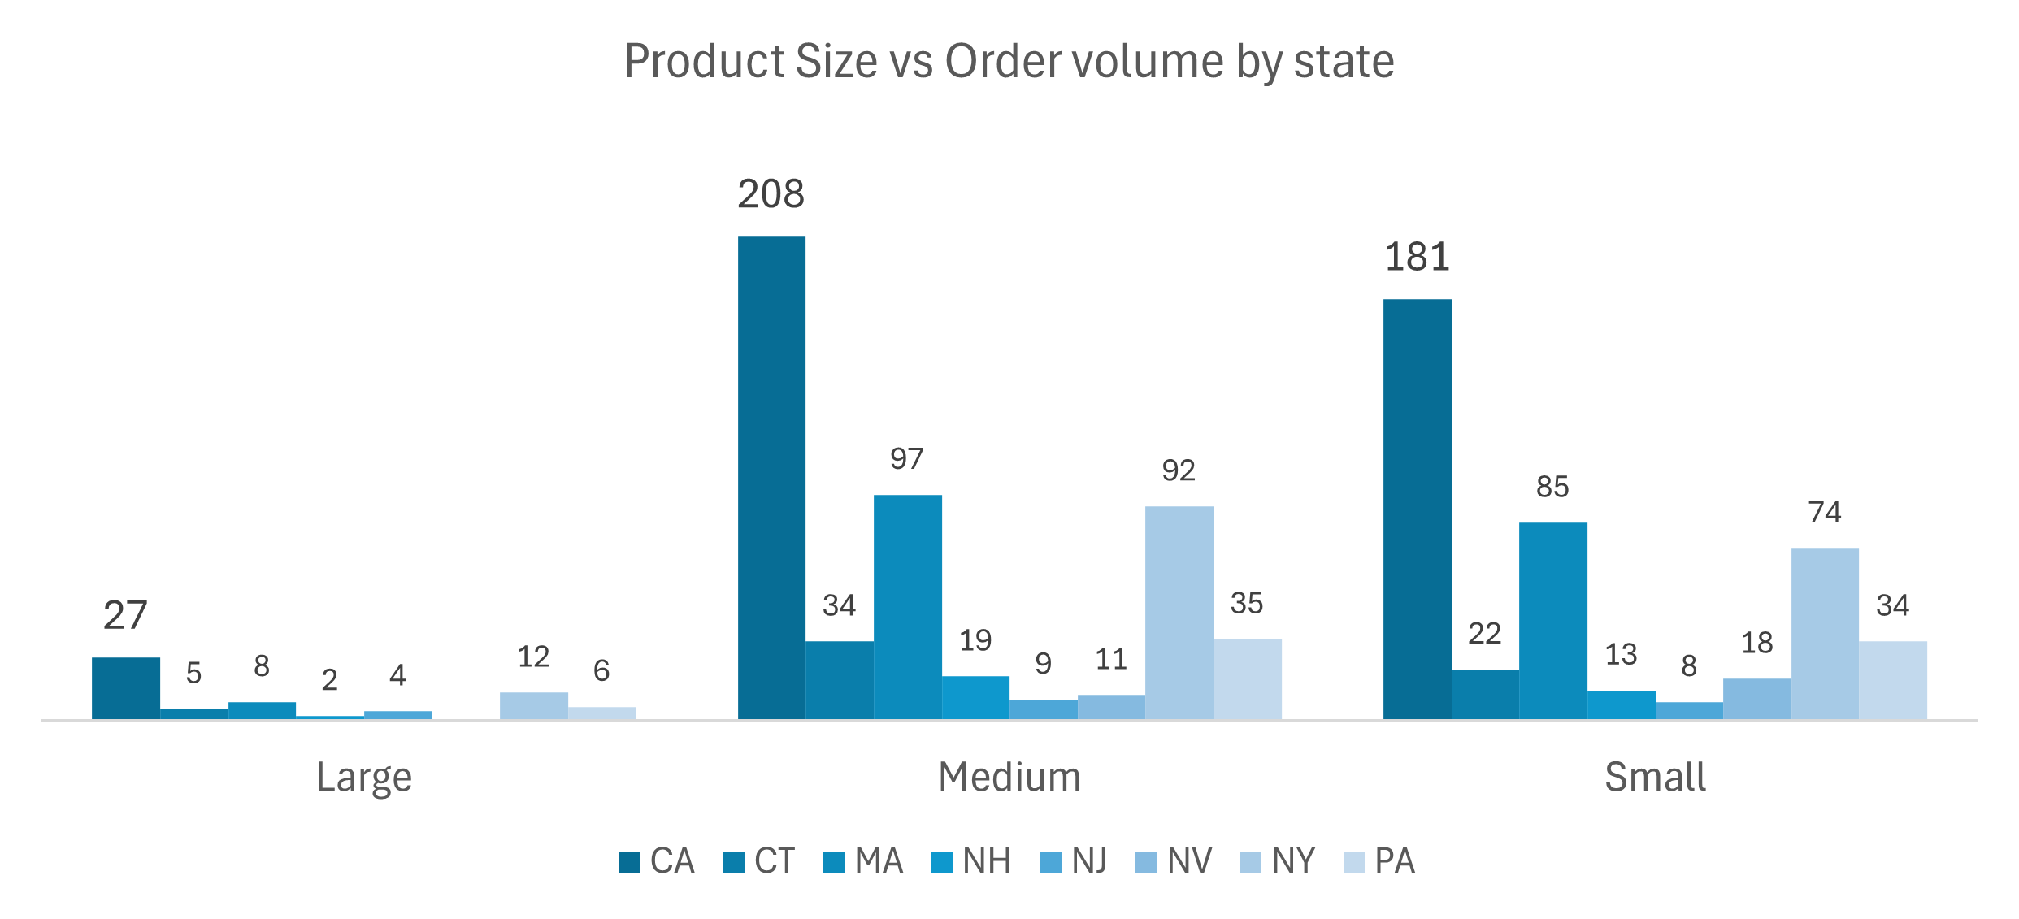
What is the relationship between order size and sales performance in different regions?
- Large Size has the lowest order volume across all states.
- Medium size has the highest order volume, particularly in California. Probably the favored by customers in the region.
- Small size has reasonable order volume, with NY and PA showing significant numbers, respectively.
Recommendations:
Develop targeted marketing strategies for medium-sized products states like California, where sales are strong.
Conduct further analysis to understand why large products have low order volumes by analysing market condition.
Consider regional promotions or discounts for small and large products in states with lower sales.

Slide 5
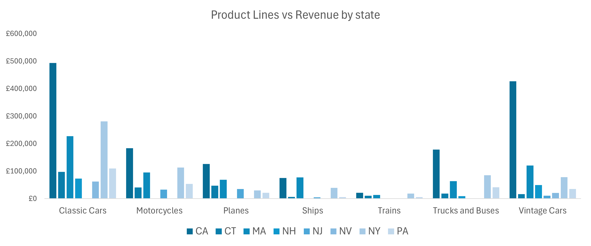
What product lines contribute most to sales in each region?
- Classic Cars drove most revenue in all regions followed by Vintage Cars, where CA drove most revenue on both product lines with total revenue of $1,344,638 and $757,756, respectively.
- Trains drove the least revenue and order volume in all states with overall revenue performance of $69,254.
Recommendations:
Develop targeted marketing strategies for Classic Cars and Vintage Cars where sales are strong.
Conduct further analysis to understand why Trains and Ships underperform overall.

Slide 6
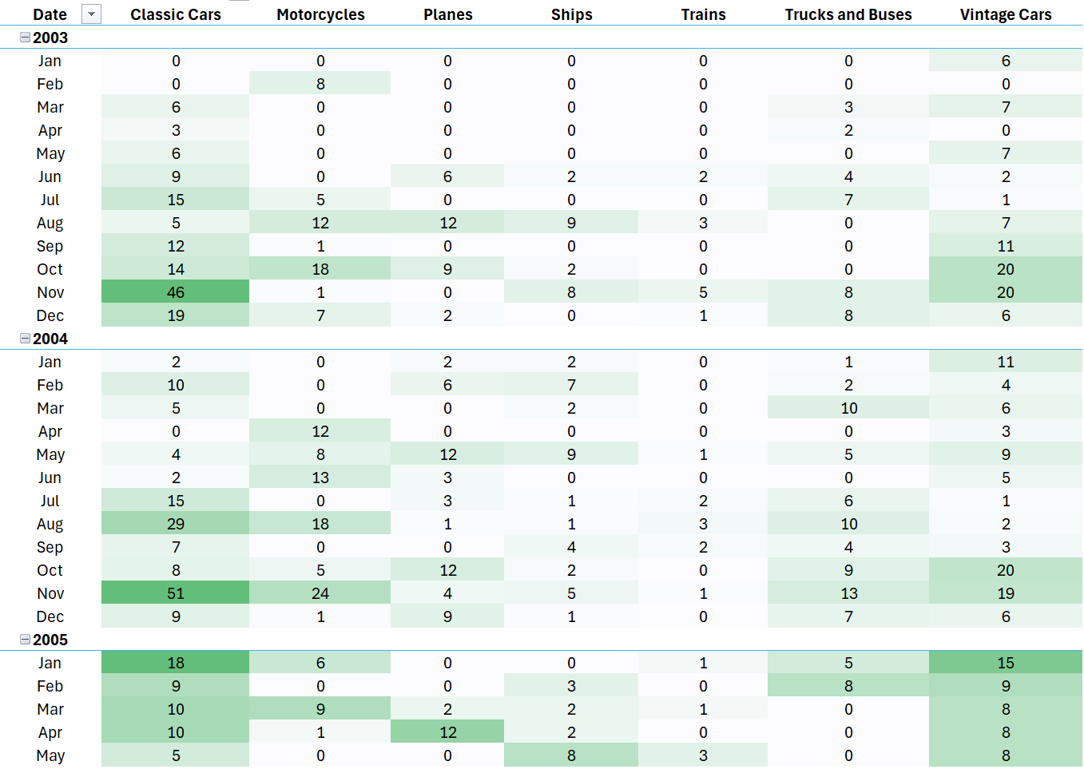
What factors might be contributing to drops during specific time periods?
- High number of months and product lines with no sales
Potential stock level issue due to high demand on specifics months
Potential open store issues in certain cities
Recommendations:
Conduct further analysis to understand why certain product lines have no sales in certain months.
Develop a survey to understand ICP in low sales demand states to conduct marketing campaigns.
Deeper time series analysis to understand seasonality with more details.

Slide 7
Conclusion
Summary of Findings:
Analysis of correlation between deal size and sales.
Identification of top-performing product lines in specific regions.
Analysis of external factors (e.g., promotions, seasonal effects) leading to sales drops.
Overall Recommendations:
Further sales analysis for improving performance based on findings.
Gather more information for better understanding of product behaviour.

Slide 8
Thank you

